Slide 1
Lecture 2 Chapter 18: Temperature, heat, and the first law of thermodynamics
18.4: Heats of transformation
When energy is absorbed as heat by a solid or liquid, the temperature of the sample does not necessarily rise. Instead, the sample may change from one phase (or state) to another.
The amount of energy required per unit mass to change the state (at constant temperature) of a particular material is its heat of transformation L.
Thus, when a sample of mass m completely undergoes a phase change, the total energy transferred is Q = mL
L = Q/m
Heat of Vaporization
The heat of vaporization L_{V} is the amount of energy per unit mass that must be added to vaporize a liquid or that must be removed to condense a gas. For water at its normal boiling or condensation temperature, Q = m L_{v} [L_{V} = 539 cal/g = 40.7 kJ/mol = 2256 kJ/kg]
L_{v} = Q/m
Heat of Fusion
The heat of fusion L_{f} is the amount of energy per unit mass that must be added to melt a solid or that must be removed to freeze a liquid. For water at its normal freezing or melting temperature,
Q = m L_{f} L_{f} = Q/m [L_{f} = 79.5 cal/g = 6.01 kJ/mol = 333 kJ/kg]

Slide 2
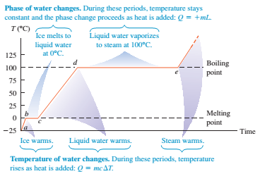

Slide 3
18.5: A closer look at heat and work
Let us take as our system a gas confined to a cylinder with a movable piston, as in Fig. The upward force on the piston due to the pressure of the confined gas is equal to the weight of lead shot loaded onto the top of the piston.
The walls of the cylinder are made of insulating material that does not allow any transfer of energy as heat. The bottom of the cylinder rests on a reservoir for thermal energy, a thermal reservoir(perhaps a hot plate) whose temperature T you can control by turning a knob.
The system (the gas) starts from an initial state i, described by a pressure p_{i} , a volume V_{i} and a temperature T_{i} . You want to change the system to a final state f, described by a pressure p_{f} ,a volume V_{f} ,and a temperature T_{f} .The procedure by which you change the system from its initial state to its final state is called a thermodynamic process.
During such a process, energy may be transferred into the system from the thermal reservoir (positive heat) or vice versa (negative heat).
Also, work can be done by the system to raise the loaded piston (positive work) or lower it (negative work).

Slide 4
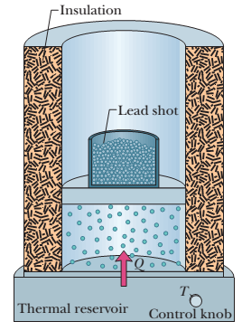
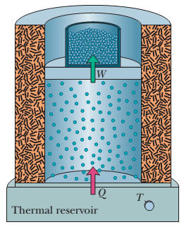
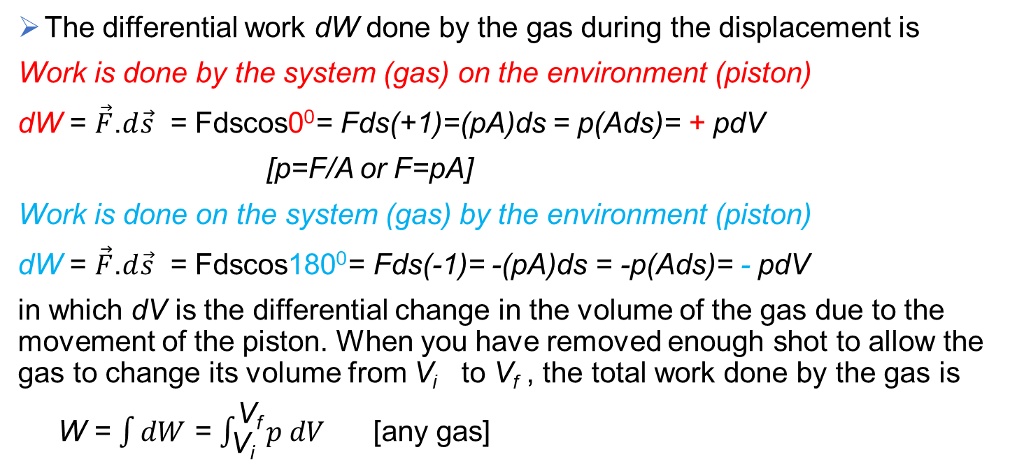
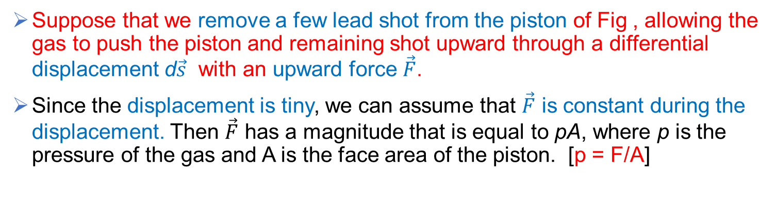
Suppose that we remove a few lead shot from the piston of Fig , allowing the gas to push the piston and remaining shot upward through a differential displacement d$\vec{s}$ with an upward force $\vec{F}$.
Since the displacement is tiny, we can assume that $\vec{F}$ is constant during the displacement. Then $\vec{F}$ has a magnitude that is equal to pA, where p is the pressure of the gas and A is the face area of the piston. [p = F/A]
The differential work dW done by the gas during the displacement is
Work is done by the system (gas) on the environment (piston)
dW = $\vec{F}$.$d\vec{s}$ = Fdscos0⁰= Fds(+1)=(pA)ds = p(Ads)= + pdV
[p=F/A or F=pA]
Work is done on the system (gas) by the environment (piston)
dW = $\vec{F}$.$d\vec{s}$ = Fdscos180⁰= Fds(-1)= -(pA)ds = -p(Ads)= - pdV
in which dV is the differential change in the volume of the gas due to the movement of the piston. When you have removed enough shot to allow the gas to change its volume from V_{i} to V_{f} , the total work done by the gas is
W = $\int{dW}$ = $\int_{\text{V}\text{i}}^{\text{V}\text{f}}{p dV}$ [any gas]

Slide 5
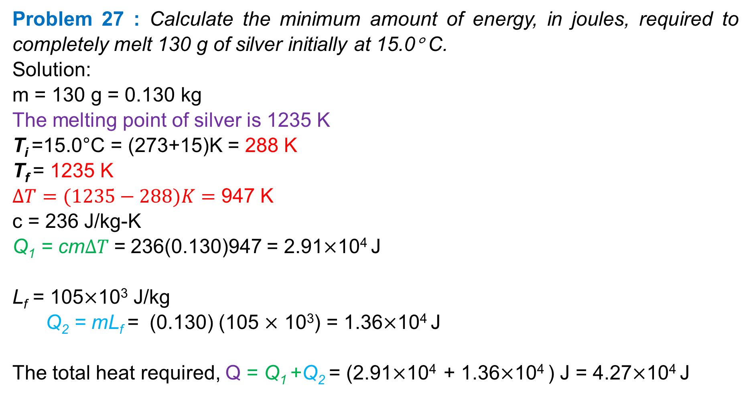
Problem 27 : Calculate the minimum amount of energy, in joules, required to completely melt 130 g of silver initially at 15.0° C.
Solution:
m = 130 g = 0.130 kg
The melting point of silver is 1235 K
T_{i} =15.0°C = (273+15)K = 288 K
T_{f} = 1235 K
$∆T=(1235−288)K=$ 947 K
c = 236 J/kg-K
Q₁ = cm$∆T$= 236(0.130)947 = 2.91$×$10⁴ J
L_{f} = 105$×$10³ J/kg
Q₂ = mL_{f} = (0.130) (105 $×$ 10³) = 1.36$×$10⁴ J
The total heat required, Q = Q₁ +Q₂ = (2.91$×$10⁴ + 1.36$×$10⁴ ) J = 4.27$×$10⁴ J

Slide 6
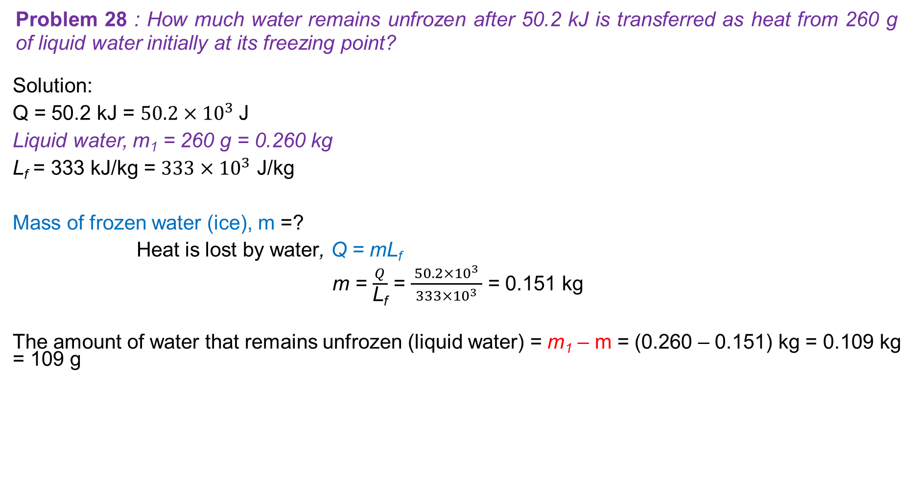
Problem 28 : How much water remains unfrozen after 50.2 kJ is transferred as heat from 260 g of liquid water initially at its freezing point?
Solution:
Q = 50.2 kJ = $50.2{×10}^{3}$J
Liquid water, m₁ = 260 g = 0.260 kg
L_{f} = 333 kJ/kg = $333{×10}^{3}$ J/kg
Mass of frozen water (ice), m =?
Heat is lost by water, Q = mL_{f}
m = $\frac{Q}{\text{L}\text{f}}$ = $\frac{ 50.2{×10}^{3} }{333{×10}^{3}}$ = 0.151 kg
The amount of water that remains unfrozen (liquid water) = m₁ – m = (0.260 – 0.151) kg = 0.109 kg = 109 g

